Slide 1
Customer Service and Accounts Receivable
Policy and Procedures
March 2026

Slide 2
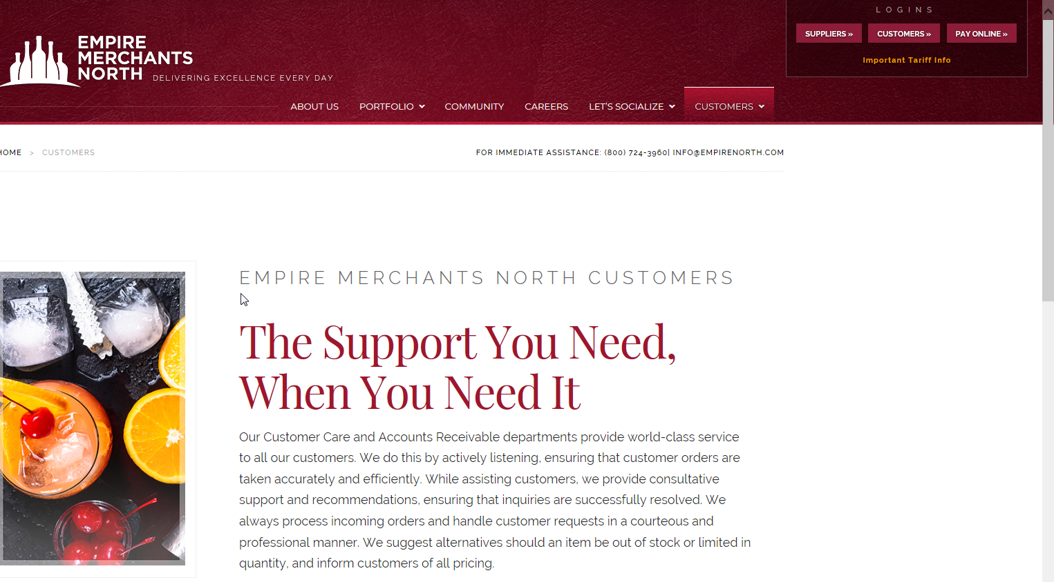
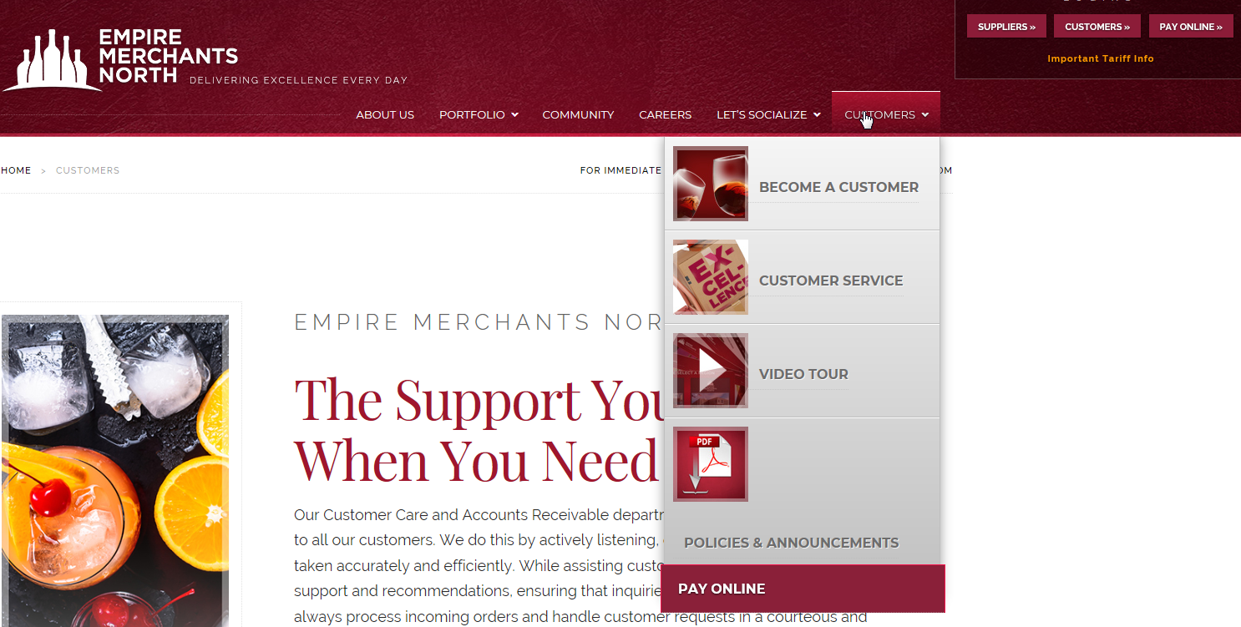
Accessing Policy/Procedure Information
Empire Merchants North policy and procedure information can be accessed from www.empirenorth.com by selecting the “Customer” tab
  - New Customer Information - Service Forms
  - Policies and Announcements - Pay Online

Slide 3
Key Contact Numbers
Customer Orders and Delivery Inquiries | 1-800-724-3960 ext. 1
Account Balance, Invoice Questions, Pay by Phone, Payments Due or Pending Credit | 1-800-724-3960 ext. 3

Slide 4
Policy and Procedures Topics*
Customer Orders
Customer Service
Credit
Credit on Delivery (COD)
* The Policies and Procedures set forth herein are subject to the laws and regulations of the NYSLA and any other authority having appropriate jurisdiction over Empire Merchants North, LLC;
* Empire Merchants North policies change from time to time. Please check with your Sales Representative as the most current information may not be reflected in this document.

Slide 5
Customer Orders
Placing of Orders
  Orders can be placed through Customer Service or your Sales Representative
Acceptance of Delivery
  Customer is required to sign a receipt/invoice acknowledging item, quantity and pricing at the time of delivery
Delivery Charges
  Empire Merchants North, LLC will charge a delivery fee on all sales orders per the following rate schedule:
    For all sales orders equal to or over $500, a $5.00 delivery fee will be assessed.
    All sales orders less than $500 will incur the current $20.00 delivery charge.
  The charge will appear on the invoices as a separate line item titled “Delivery Charge”
  In accordance with NYS law, an account that does not pay the delivery charges will be put on the Delinquent List with the NYSLA.
  Only regular sales orders are used to see if the $500 limit has been reached

Slide 6
Customer Orders: Customer Storage Fees
Customer Storage Rates : Effective August 15, 2022
  The “In fee” will be $0.65 per case, assessed when goods are initially put into storage. This new rate will be effective for goods in storage on or after August 15, 2022.
  Storage charges will be billed on a daily basis at a rate of $0.021 per case per day based on the ending inventory in storage at the end of each day for the first 18 months that the goods are in storage. A daily charge shall include the day the goods go into storage and each day up to and including the day the goods are delivered or otherwise disposed of. The new rate will be assessed starting on August 15, 2022.
  Goods must be removed after 18 months. Should you fail or refuse to remove the goods after 18 months, the storage charges will increase to $1.65 per case per day for the remaining inventory.
Customer Storage Release Fee: Updated April 1, 2024
  A $5.00 delivery fee will be charged when goods are released from Customer Storage only if there are no other regular deliveries to the same location on the same day.
  This fee will be shown on your monthly Customer Storage invoice and will reference the date of the Customer Storage deliveries

Slide 7
Customer Orders: Releasing Customer Storage Orders
Releases may be in any full case quantity
Sales reps can release Customer Storage orders through iPad or by calling Customer Service
Customers can release Customer Storage goods by calling the Customer Service or their Sales Rep
Refusals and short shipments at time of delivery will be added back to the Customer Storage inventory (full cases only).
Credit will be issued for bottles broken, unsaleable or short at the time of delivery

Slide 8
Customer Orders: Next Months Orders
Regular Sales Orders can be placed either by the Sales Rep (using iPad) beginning at 7:00p.m. on the day before the last ship day of the month, or by calling Customer Service between 8:30 a.m. and 5:30 p.m. on the last business day of the month
  Only one customer’s order will be taken on each phone call
Changes to these dates are made known via a Monthly Calendar on EMN’s website under Customers Log In/Customer Dashboard/LA Ordering
The notice of monthly Limited Availability (LA) allocated items and available order day(s) are provided on EMN’s website

Slide 9
Customer Service Overview
General Information
Pickups & Exchanges
Quantity Discounts
Backorders
Invoice & Credit Memo Disputes
Delivery Information
Customer Service Forms
Bill to/Ship to
Limited Availability (LA) Items
Non-Alcoholic Sales

Slide 10
Customer Service: General Information
Customer Service Inquires
  Telephone number 1-800-724-3960
  Email EMNcustomerorders@empirenorth.com
  Website: www.empirenorth.com/customers/customer service/service form
Standard information required for all Customer Service inquiries
    Customer Number
    Invoice Number
    Date of Invoice
    Item number(s)

Slide 11
Customer Service: Pickups and Exchanges
Merchandise Picked Up for Credit
  Request must be submitted within 14 calendar days of date of delivery for a valid reason that will be documented.
  The approved credit for product will be attached to the most current invoice that references that same product.
Exchange for breakage upon delivery
  Full cases will be replaced
  Bottles are credited
Exchanges for un-saleable items at time of delivery
  Must be called in as soon as possible but no later than 4 months. Closeout items cannot be picked up or exchanged (Final Sale)

Slide 12
Customer Service - Pickups & Exchanges (cont.)
“Mis-picked Item”
  Merchandise to be exchanged when the customer is billed for one item but received another item
    Must be called in immediately
    In addition to the standard information that is needed, Customer Service must be provided with the mis-picked item
    Confirmation is not given from the Customer Service Rep as the Inventory Control Department will need to investigate the situation. Customer Service will follow-up with the Customer

Slide 13
Customer Service - Quantity Discounts
Quantity discounts must be on one invoice
If an item is short shipped on the invoice, un-saleable, repacked and/or broken on delivery, item will be reordered to replace case(s) for the quantity it returned of the item automatically.
In the event, an item is refused, the quantity discount will be re-calculated

Slide 14
Customer Service - Backorders for Out-of-Stock Items
Ordered quantities of 1 case or more that are not fulfilled due to product availability will be retained as a backorder until 30 days into the following month.
Product on backorder will retain pricing and quantity discount from original order.
Products price filed as limited availability are retained until current months end.
Product will be shipped with the customer’s next new sales order.
Distributor and Supplier made Combination Packs will backorder for both On and Off Premise customers

Slide 15
Customer Service Disputes
Invoice and Credit Memo Disputes
If a Customer claims to have not received an item on the invoice,
  Customer Service must be provided with the standard information required for Customer Service inquires
If a credit memo is being disputed, Customer Service must be contacted with the standard information and credit memo. An investigation will be launched

Slide 16
Delivery Information
Deliveries must be made to the licensed premise.
Request for delivery change for a customer’s date and or delivery time window can be made by emailing EMNLogistics@empirenorth.onmicrosoft.com and emncustomerorders@empirenorth.com

Slide 17
Empire North’s Website: Customer Service Forms
Customers and Sales Representatives are encouraged to request all types of Customer Service inquiries online
Go to www.empirenorth.com
  Select the “Customer” tab, click on “Customer Service” and then select “Service Forms” to fill out the necessary fields
  Policy FAQs are available on the website for future reference under “Policy and Announcements”

Slide 18
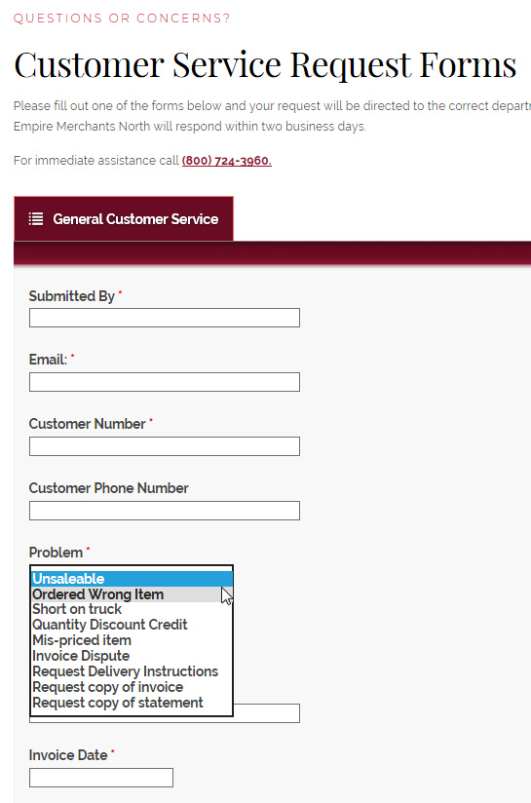
Customer Service - Service Forms
You can choose the problem you need corrected from a drop-down menu
  Problems include…
      - Invoice Dispute - Unsaleable
      - Ordered wrong item - Quantity Discount Credit
      - Short on truck - Mis-priced item
You can choose the action
you want taken from a drop down
menu and complete all required fields

Slide 19
Bill to /Ship to
For customers that utilize their own warehouse to store goods
  The Retailer must obtain a valid warehouse permit from the SLA in order for Empire North to deliver to the designated premise.
  In general, warehouse permits expire on 12/31/2023 (every 3 years)
  An authorized person from the retailer must be present to sign for the goods delivered

Slide 20
Limited Availability(LA) – Allocated Items
Sales determines which items are allocated and the method of allocation
Specific quantities of allocated items are loaded into SAP by Sales/Pricing
Allocated items can be ordered through your Sales Representative (using iPad) or by calling Customer Service
All Distributor Made and Supplier Made Combination Packages must be allocated and reported to the SLA
Limited Availability Calendar is available at https://empire360.com/pages/documents/#la

Slide 21
Non-Alcoholic Sales
Per SLA Advisory, non-alcoholic wine or spirits are only available to On Premise accounts.
Off Premise accounts are not permitted to carry such products.
New Accounts – If an account does not sell alcoholic beverage, please reach out to Credit to discuss.
There will be a separate invoice for non-alcoholic products; All current fees apply to the sale of non-alcoholic products.
The delivery fee will be presented on the alcoholic invoice unless the customer has only ordered non-alcoholic items, then the delivery fee will be on the non-alcoholic invoice. The total of alcoholic and non-alcoholic items are used to determine the delivery fees.
Accounts cannot be put on the default list for failure to make timely payments of the non-alcoholic items.
Non-Alcoholic invoices will be deemed past due on the 35th day. They will not be reported to the SLA, but the account will be made internal COD until the past due invoice is paid in full.

Slide 22
Customer AR/Credit Department Overview
Empire360 and Pay by Phone
Payment Methods of Accounts Receivable
Reporting to State Liquor Authority (SLA)
Establishing Credit Terms for Customers
Changing a Customer’s Credit Status
Outside Collection Agency Procedures

Slide 23

Empire360 and
Pay by Phone

Slide 24
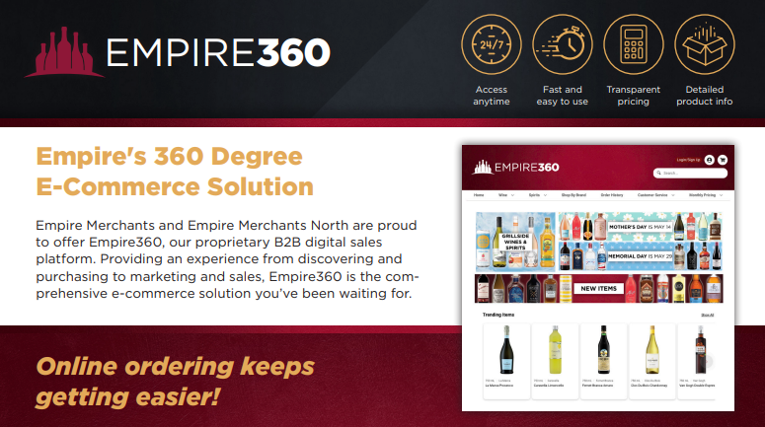
Empire360.com

Slide 25
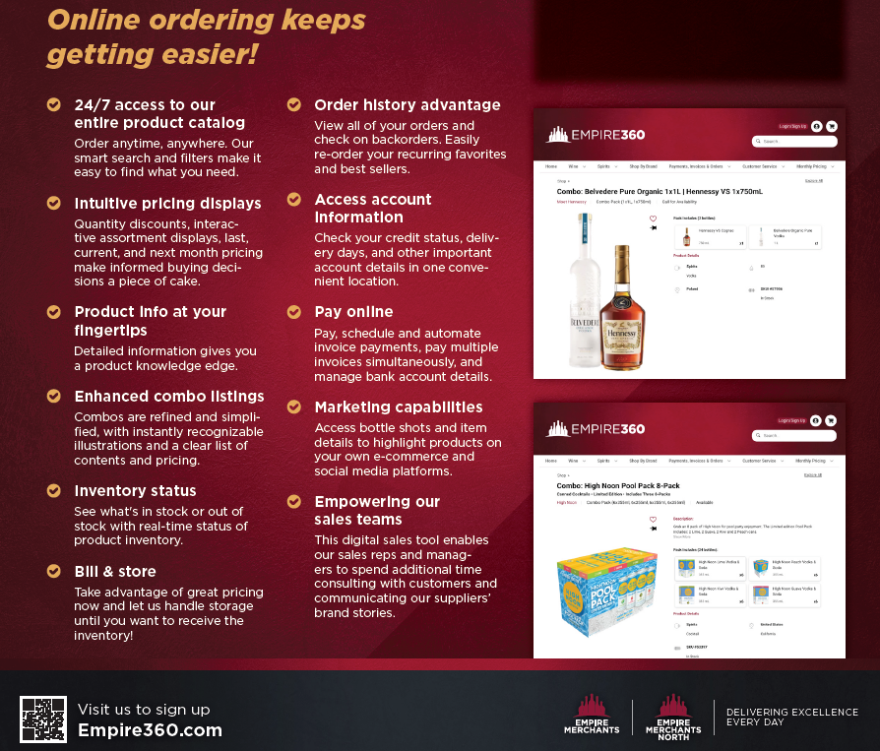

Slide 26
Empire360 – Capabilities
Current features
  Order Online
  Assortment/Quantity Discount Pricing Information
  Last time an Item was purchased display
  Ability to search for combination packs (combo’s)
  Order History (items previously purchased, quantity and price paid)
  View current inventory (in stock, low stock and out of stock)
  Ability to order and release B&S
  View credit status
  View PDF versions of invoices
  Pay invoices online
  Auto Payment Scheduler
Coming soon….
  Ability to find “Where is my truck”
  Order distributor combo’s
  Plus, much more…

Slide 27
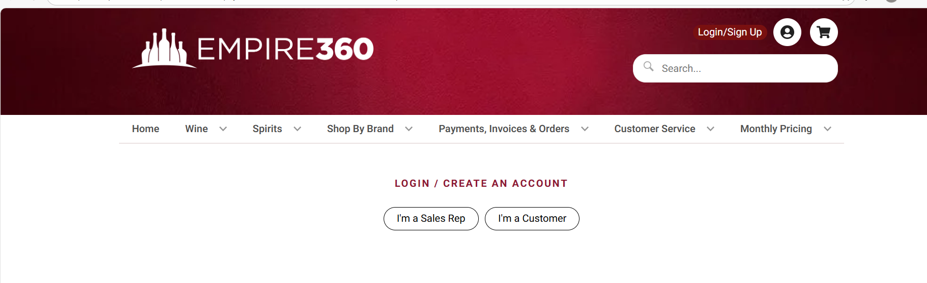
Empire North’s Online Homepage
http://www.empire360.com

Slide 28
Empire360 – Login information
Empire360 is free to sign up and use if you are already an Empire Merchants North customer.
  If you are not a customer, you must complete the “New Account Application” process before an Empire360 account can be established.
  Once the customer is logged in, pricing information is available.
Customers and Sales Reps can log into Empire360
  For Customers: go to www.empire360.com and click Log/In Sign up. Click on “I’m a Customer”. Enter your email and password.
  For Customer Service and Sales: go to www.empire360.com and click Log In/Sign Up. Click on “I’m a Sales Rep”. Enter your email and password.

Slide 29
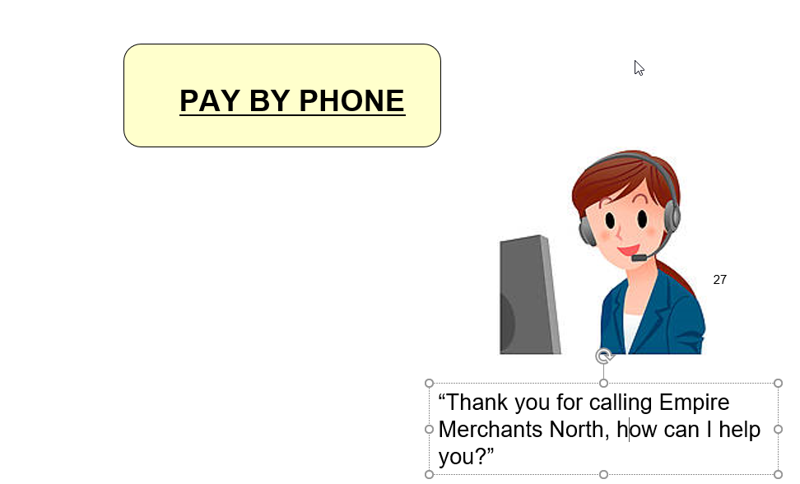
Invoices can be paid by calling Customer AR

Slide 30
Pay by Phone
Allows Customers to pay their invoices over the phone
  Call the Customer Accounts Receivable (AR) Dept. at 1-800-724-3960 ext. 3
  Customer can instruct the Customer AR rep to make a payment for the same day or to schedule a future payment
  Can pay invoices as well as make on account payments
Secure process
  Banking information needs to be provided
  Inbound phone calls are recorded to document transaction
  Customer’s PIN Code will need to be provided to validate identity
  Customer must have a signed ACH enrollment form on file

Slide 31
Benefits of “pay by phone”
All the same benefits of Empire North’s “Pay Online”
  Convenience
  Easy to use
  No need for sales reps to pick up check
  No last-minute overnight mail
  Can schedule payments
  Self Service
Retailers can pay invoices as needed over the phone up to 5:00pm

Slide 32
Payment Methods at Empire Merchants North
Payments can be received via US Mail, overnight services, courier, directly from Sales Representatives or Drivers and electronically.
    Empire360.com
    Pay by Phone
    Corporate Check
    Bank Check
    Money Order
All payments must have the same name as their liquor license. Third party payments are not accepted.

Slide 33
NYSLA – Default Reporting
It is the responsibility of the Customer AR Department to comply with New York State Liquor Authority (NYSLA) regulations.
Customers will be reported to NYSLA under the following conditions:
  Payment is not received for the invoice amount and delivery fees from any Customer according to the NYSLA credit calendar schedule. The type of reports issued are:
    Delinquent report
    Report in Dispute
  Check/Electronic payment is returned unpaid.
    Returned check will be subject to a $30 fee
Published interest and service charges will continue to be assessed on all delinquent balances.

Slide 34
NYSLA – Default Reporting (Continued)
If payment for an invoice is not received by the due date:
  Customer will be reported to the NYSLA as “Delinquent” as specified by the SLA.
  Customer is put on COD credit status.
  Payments for COD invoices must be received on the date the goods are delivered.
If payment is received but a small balance remains unpaid:
  Customer will automatically be considered “In Dispute”.
  The Customer credit status will remain unchanged.
  If the disputed amount is not resolved within 7 calendar days of the delivery date, the Customer will be reported as “Delinquent”.

Slide 35
SLA – Issuing Default Notices
Issuing Notices of Payment (on default balance) to NYSLA
Payment is received for outstanding merchandise defaults, previously reported to the NYSLA.
Notification is sent to the NYSLA informing them of payment.
The NYSLA releases the Customer from default status when all of their outstanding reports (with all wholesalers) have been satisfied.
Customer may then be considered for a change to Open Terms status.
If the Customer status is COD and not listed in default by the NYSLA, the Customer can request to be placed on Open Terms status; however, credit decisions will be made on a case-by-case basis by the Credit Department.

Slide 36
SLA Default Email Notification Program
SLA Advisory allows Retailers to receive email Default Notifications
The email notification service is completely voluntary.
    Customers may opt out and the Notice of Default will be sent via US Mail within 24 hours of the delinquency reporting.
Customers who have signed up will receive two separate emails:
    1st Notice - Invoices due to be reported to the SLA on or before the final payment date.
    2nd Notice - Notice of Default on the same day the Customer is reported “Delinquent” with SLA on its website.
Customers who participate in the email notification service will receive email notification in lieu of US Mail.

Slide 37
SLA Default Email Notification Program Benefits
Customers must complete the required enrollment form to sign up for SLA Default Email Notification program. This form can be located at www.empirenorth.com.
Customers will be notified of invoices coming due - (1st Notice).
Customers can then follow-up with their Sales Representative or the Customer AR Department if there are issues or questions.
Customers will be notified the day they are reported by Empire Merchants North with the default amount - (2nd Notice).
Combined with Empire360, a Customer has a powerful way to resolve a delinquent SLA status quickly and efficiently.

Slide 38
Establishing Customer Credit Terms
Customer credit terms are set when a Credit Application is submitted and approved by Customer AR Management.
New On and Off Premise Customers requesting credit terms must fill out the New Account Application and an Empire North Personal Guaranty in the exact legal business entity as registered with the NY Department of State and archived on its website.
The Personal Guarantor must be named on the NYSLA license.
  An Empire North Credit Application is required for all new accounts.
  A credit report will be run on the individual(s) who signs the Personal Guaranty as they are taking responsibility for payment to Empire North. Upon receipt of a signed form that provides approval to Empire North to request a credit report, the credit report will be run.
  This credit report will help determine credit status.
  All credit information will be kept strictly confidential.
  Accounts that refuse to provide a Personal Guaranty will be placed on COD for all deliveries.

Slide 39
Establishing Customer Credit Terms (Continued)
On-Premise Customers only owned by the same individual may submit an “Also Owns” form to help establish Open Terms credit.
  The “Also Owns” form shows the Customers that are owned by the same individual, and that they are all to be taken into consideration when determining credit status and/or credit limit.
  Customers listed on the “Also Owns” form may, from date form is submitted, be considered linked for credit purposes, but obtaining individual Personal Guarantees for each entity is best practice.
Personal Guaranty and “Also Owns” forms can be obtained by calling the Customer AR Department at 1-800-724-3960 ext. 3 or by going online to www.empirenorth.com.
Personal Guarantees must be filled out completely and accurately, using the exact legal entity as registered with the NY Department of State - the original document must be signed and returned to the Credit Department.

Slide 40
Requesting Customer Credit Status Changes
Requesting Credit Status Change to Open Terms
  The Customer AR department reviews the SLA Delinquent list daily
  If a Customer is not reported “Delinquent” on the SLA website, has no open CODs outstanding, and is deemed credit worthy by Credit Management, the credit status may be changed to Open Terms based upon Credit Management review.
  Ultimately the decision to put an account on Open Terms is determined by Credit Management

Slide 41
Requesting Customer Credit Status Changes (Continued)
Requesting Credit Status Change to Open Terms
  Even if a Customer does not appear “Delinquent” with SLA, Open Terms credit status is not guaranteed.
  In order to remove Customers from “Delinquent” status with the SLA in a timely manner, Empire North requires all contact with NYSLA to go through the Customer AR Department
  If a solicitor wishes to check on a default filing, it should be directed through the Customer AR Department.
  Solicitors should not contact SLA directly.

Slide 42
COD Status and Collections
Releasing COD: Money Order/Certified/Bank Check orders
Requesting a COD: Money Order/Certified/Bank Check to COD status change
Placing Customers with Outside Collection Agency

Slide 43
COD - Releasing Money Order/Certified Check Orders
Sales Representative or Driver must have in hand, a certified/bank check or money order in the amount of the order.
  The Customer AR department does not accept cash.
  Cash payments are not accepted by any department at Empire Merchants North.

Slide 44
Requesting COD: Money Order/Certified Check to COD
The decision to change COD Money Order/Certified/Bank Check terms to any other terms is determined by the Customer AR Department.
All open COD: Money Order/Certified Check orders must be paid in full to be considered for a credit status change.
If payment is not received on day of delivery, product will not be delivered
If a Customer is constantly late paying CODs, bounces too many checks or is otherwise deemed unworthy of COD, the credit status may remain COD: Money Order/Certified Check.

Slide 45
Placing Customers with Outside Collection Agency
When all Empire North Customer AR Department internal collection efforts on delinquent balances have been exhausted, it may be necessary to send a Customer to an outside collection agency.
Customer receives a “10 Day Final Demand Notice” via US Mail.
Sales Representative receives an email notification from the assigned Collection Agent that the demand letter has been sent.
Once a Customer is turned over for collection, all correspondence and payments concerning past due amounts should be directed to:
      The Commercial Collection Corporation of New York, Inc.
        34 Seymour Street
        Tonawanda, NY 14150
        Phone Number 1-800-873-5212
        Fax Number 1-800-873-5211

